Slide 1


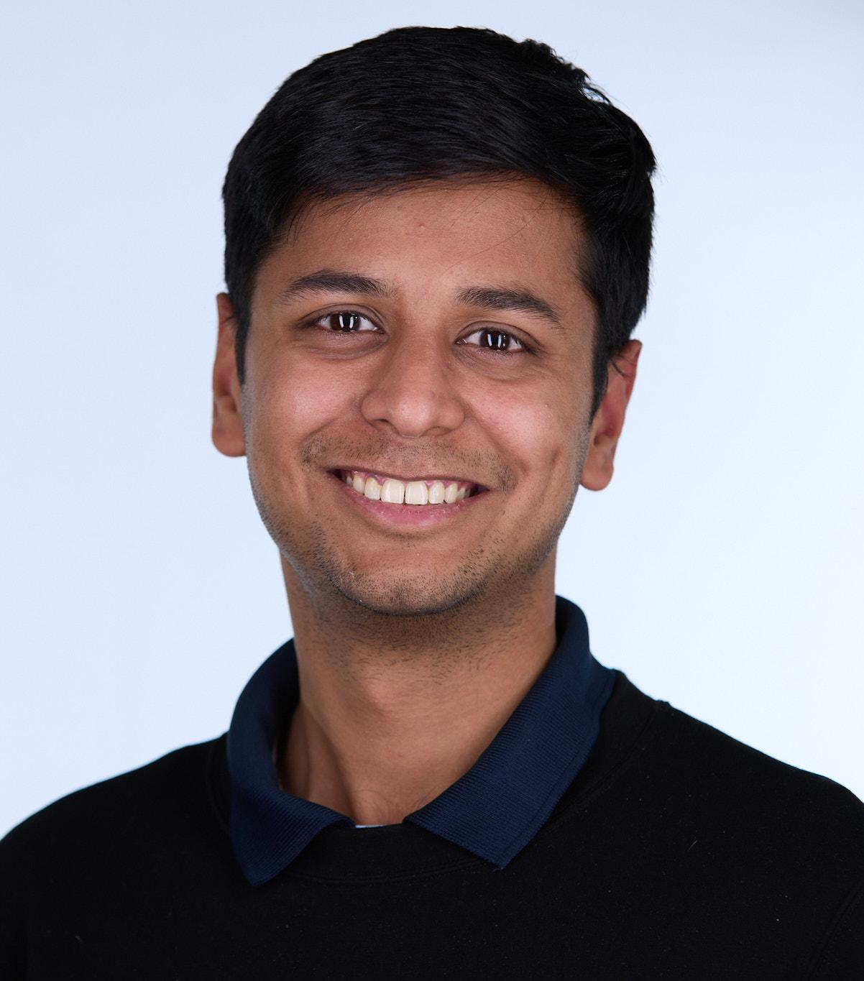
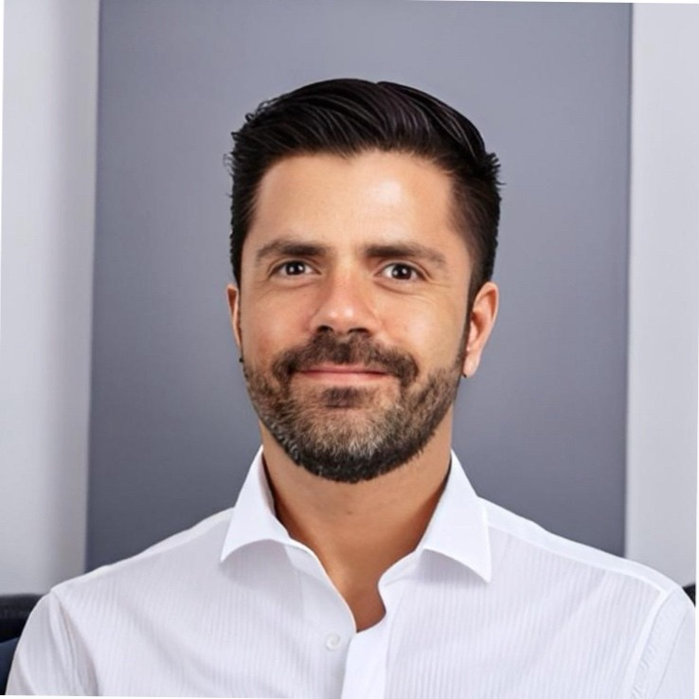
Team:
Vismitha Narayanaswamy
Ayush Srivastava
Carlos Schenone Poggi
May 2, 2024

Slide 2
Agenda:
Problem Statement
Project Objective
Gemini API Overview
Proposed Solution
Technology Stack
Challenges and Solutions
Impact and Future Work
Demo

Slide 3
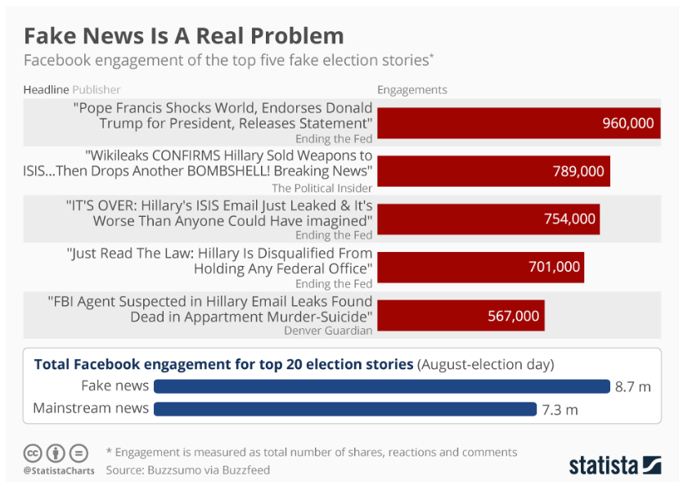
Source: https://researchguides.austincc.edu/c.php?g=612891&p=4258046

Slide 4
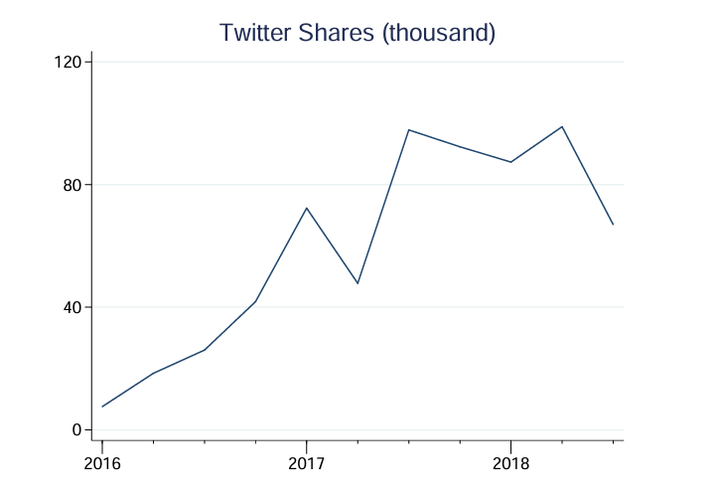
Shares on Twitter for Fake News URLs
Source: https://web.stanford.edu/~gentzkow/research/fake-news-trends-appx.pdf

Slide 5

Problem Statement
Fake news represents misinformation or fabricated information that mimics news media content in form but not in organizational process or intent. The dissemination of fake news often aims to mislead or exploit readers' biases.
Some big brands are still finding their ads supporting bad sites and inadvertently supplying thousands of dollars to those outlets.
Advertising Revenue: Advertisers waste funds on sites that misalign with their values, risking customer alienation due to unintentional support of unethical content.
Brand Integrity: Ads placed near disreputable content can damage a brand's reputation, suggesting unintended endorsement and eroding consumer trust.
Source: https://www.marketingdive.com/news/ad-placements-on-fake-news-sites-continue-to-befuddle-brands/432009/
Source: https://unsplash.com/photos/people-in-white-and-yellow-hijab-standing-in-front-of-building-during-daytime-WoEEz25tUmc

Slide 6


Project Objective
To develop a tool that uses the Gemini API to detect websites spreading fake news and prevent advertisements from being displayed on such pages. We aim to develop a prototype tool that does the following:
Accurately identify websites spreading misinformation.
Automatically block ad placements on these identified sites.
Provide advertisers with a safer, more transparent digital environment.
Google's mission is to "organize the world's information and make it universally accessible and useful."
Source: https://unsplash.com/photos/a-red-fake-news-sign-hanging-from-the-side-of-a-wall-mqxWa-u-wNM
By using the Gemini API, our project helps organize and clarify the information landscape by promoting truthfulness and reliability.

Slide 7

Gemini API Overview
Gemini-1.5-pro-latest offers powerful tools for detecting fake news:
Contextual Understanding: Analyzes article context to distinguish legitimate news from misleading content.
Pattern Recognition: Trained on diverse datasets to identify misinformation patterns, such as sensational language or inconsistent facts.
Scalability: Efficiently processes large volumes of data across multiple platforms, crucial for real-time fake news detection.
Adaptability: Continuously updates and adapts to new misinformation tactics.
Bias Reduction: Minimizes human bias, enhancing objectivity in news validation.
Source: https://unsplash.com/photos/a-computer-chip-with-the-letter-a-on-top-of-it-eGGFZ5X2LnA

Slide 8
Proposed Solution
User Interface
Content Processing
Gemini-1.5-
pro-latest
Ad network Interaction Module
Reporting and Analytics
Components:
Data Source: Stream of news articles or social media posts from various sources (web crawlers, APIs,etc.).
Preprocessing: Removing harmful content, neutralising tone, normalizing text, and performing text cleaning techniques.
Gemini API Integration: Gemini-1.5-pro-latest.
Analyzes the text for signals indicating fake news, by identifying language patterns and factual grounding.
Fake News Score: Gemini assigns a "fake news score" to the text, indicating the likelihood of it being fake news.
Numerical score between 0 (low likelihood) and 1 (high likelihood).
Pre defined threshold for assigning truth value to news, trained on custom dataset
Action & Reporting: Flagged news articles can be:
Displayed with a warning label to users.
Down Ranked in search results to reduce visibility.
Reported to the platform where it originated.
Ad Network Integration: The system can integrate with ad networks to -
Block ads from appearing on flagged fake news articles.
Target advertising based on factual content identified by Gemini.
Notes:
https://www.kaggle.com/datasets/emineyetm/fake-news-detection-datasets

Slide 9
Criteria for Fact check
We explored various few shot Prompts to access which of them gave us better results. Below is the Prompt that performed better.
1. Reputation and Credibility: Research the source's background, reputation, and potential biases. Are they known for accuracy and fact-checking? Do they have a history of publishing false or misleading information?
2. Accuracy and Evidence : Verify the information presented against other reliable sources. Find a sufficient number of sources claiming the truth. Does the information align with established facts and research? Are claims supported by evidence, such as data, statistics, or expert opinions?
3. Logic and Reason : Evaluate the logic and reasoning presented. Does the information make sense? Are there any logical fallacies or inconsistencies?
4. Objectivity and Fairness: Consider if the information is presented objectively or if it appears biased or one-sided. Does it present multiple perspectives, or does it only focus on a specific viewpoint?
5. Language and Tone: Pay attention to the language and tone used. Is it overly emotional, sensationalized, or inflammatory? Reputable sources typically use neutral and objective language.
6.Fact-Checking Websites : Utilize fact-checking websites like Snopes, PolitiFact, or FactCheck.org to verify claims and debunk misinformation.
Notes:
https://www.kaggle.com/datasets/emineyetm/fake-news-detection-datasets

Slide 10
Technology Stack
Python: For backend development due to its extensive support for data processing and machine learning.
Frameworks: Django for web server implementation..
HTML/CSS: For building and styling user interface
MySQL: Django ORM interacts with MySQL to store user data, processed content, results from the Gemini API, and logs for analytics.
APIs:
Gemini API: Gemini-1.5-pro-latest for analyzing the content to detect signs of fake news.
Ad Network APIs: For integration with ad networks to control ad placement based on content credibility.
5. Dataset: The dataset consists of articles sourced from real-world environments. Legitimate articles were gathered by scraping content from Reuters.com, a reputable news website. In contrast, the fake news articles were sourced from various unreliable websites identified by Politifact, a U.S.-based fact-checking organization, and Wikipedia. While the dataset covers a range of topics, it predominantly includes articles focused on politics and international news. 1. G. McIntire, Fake or Real News, (2017). https://github.com/joolsa/fake_real_news_dataset 2. UTK Machine Learning Club, Fake News, (2018). https://www.kaggle.com/c/fake-news/overview
3. Trends in the Diffusion of Misinformation on Social Media
https://web.stanford.edu/~gentzkow/research/fake-news-trends-appx.pdf

Slide 11

Challenges and Solutions
Challenges:
Strategies to Overcome: Error Handling: Implemented try-catch blocks around the content processing to catch exceptions like “StopCandidateException”. - Logging these incidents for review and monitoring to adjust content filters or understanding user behavior patterns. - Using text summarisation and content filtering models to neutralise the tone and paraphrase.
Stop Candidate Exception | Process stops when explicit harm content is provided as an input. No defined standard can be flagged as harmful by Gemini 1.5 pro
Recency of News | Since Gemini is trained on set period of data, news articles outside of the time period are not accurately analysed
Language | Gemini checks for language clarity, but correct news sometimes have incorrect grammar usage. So its difficult to measure accuracy from language use.
Source: https://unsplash.com/photos/a-chalkboard-with-the-word-possible-written-on-it-Jxi526YIQgA

Slide 12
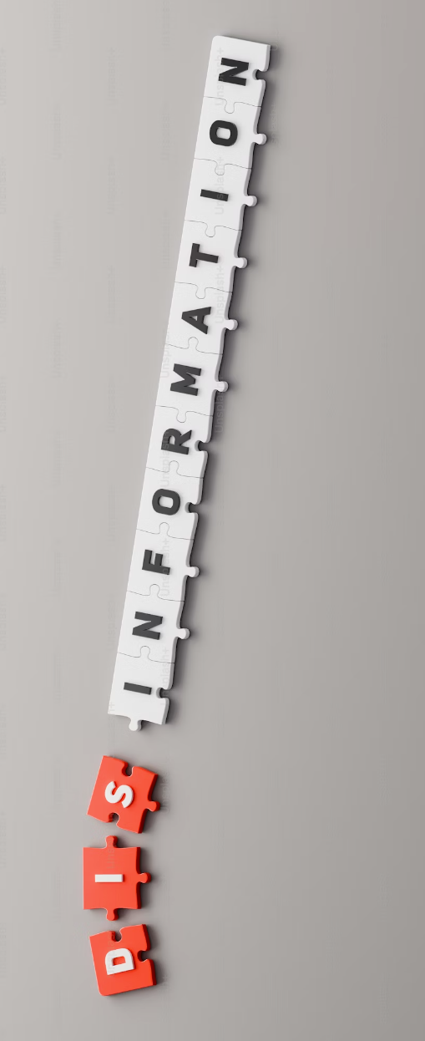
Impact
Market Impact:
Advertising Industry: Our tool decreases the risk of ads appearing on fake news sites, safeguarding ad spend and bolstering brand reputation for more ethical and effective advertising.
Public Discourse: Reduces fake news exposure, fostering more informed public discourse and supporting decision-making based on accurate information.
Source: https://unsplash.com/photos/a-piece-of-paper-with-the-word-phis-on-it-YkEs3Jg51hY

Slide 13

Demo

Slide 14
Team:
Vismitha Narayanaswamy
Ayush Srivastava
Carlos Schenone Poggi
May 2, 2024

Slide 15

Future Work
New Markets: The tool can expand to various languages and regions, adapting to diverse regulatory and cultural landscapes.
Feature Expansion: New features could include real-time alerts for advertisers, integration with more ad networks, and enhanced detection tools to tackle emerging misinformation forms.
Source: https://unsplash.com/photos/silhouette-photography-of-person-oMpAz-DN-9I

